Slide 1
HTML5 & CSS 3
Day 2
<Eng. Muhammad Omar Elnatory />

Slide 2
CSS3
New version of CSS.
Still support CSS old versions.
New updates for browsers support css3.
CSS3 is completely backwards compatible, so you will not have to change existing designs. Browsers will always support CSS2.
The CSS3 specification is still under development by W3C, However, many of the new CSS3 properties have been implemented in modern browsers.

Slide 3
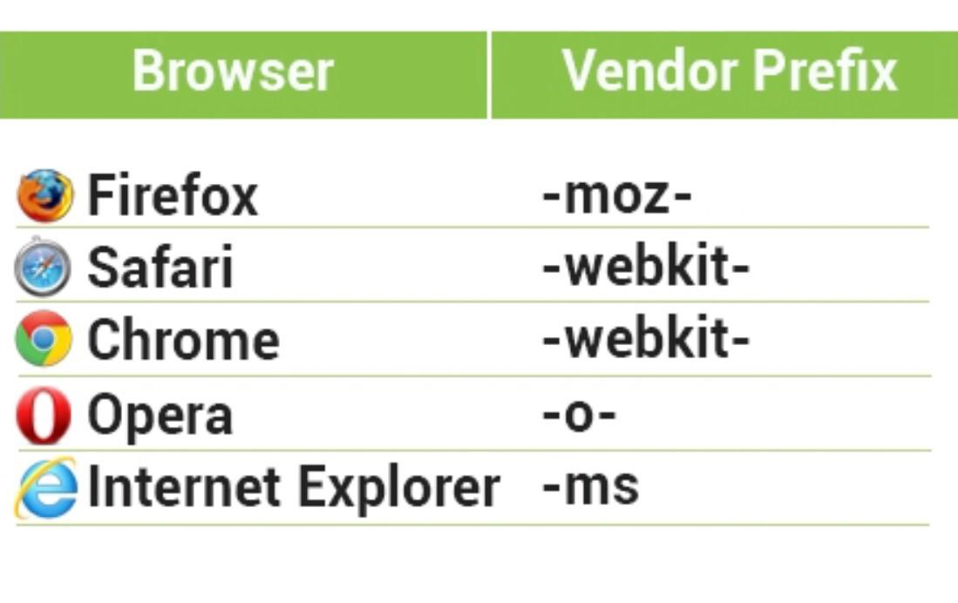
Vendor prefix

Slide 4
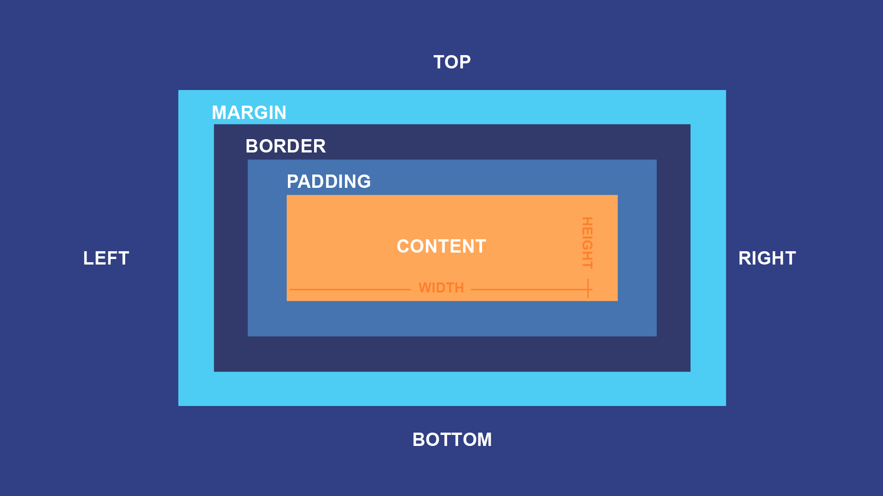
Box modal

Slide 5
Box modal
Width
Height
Total size
Display: inline, block, inline-block

Slide 6
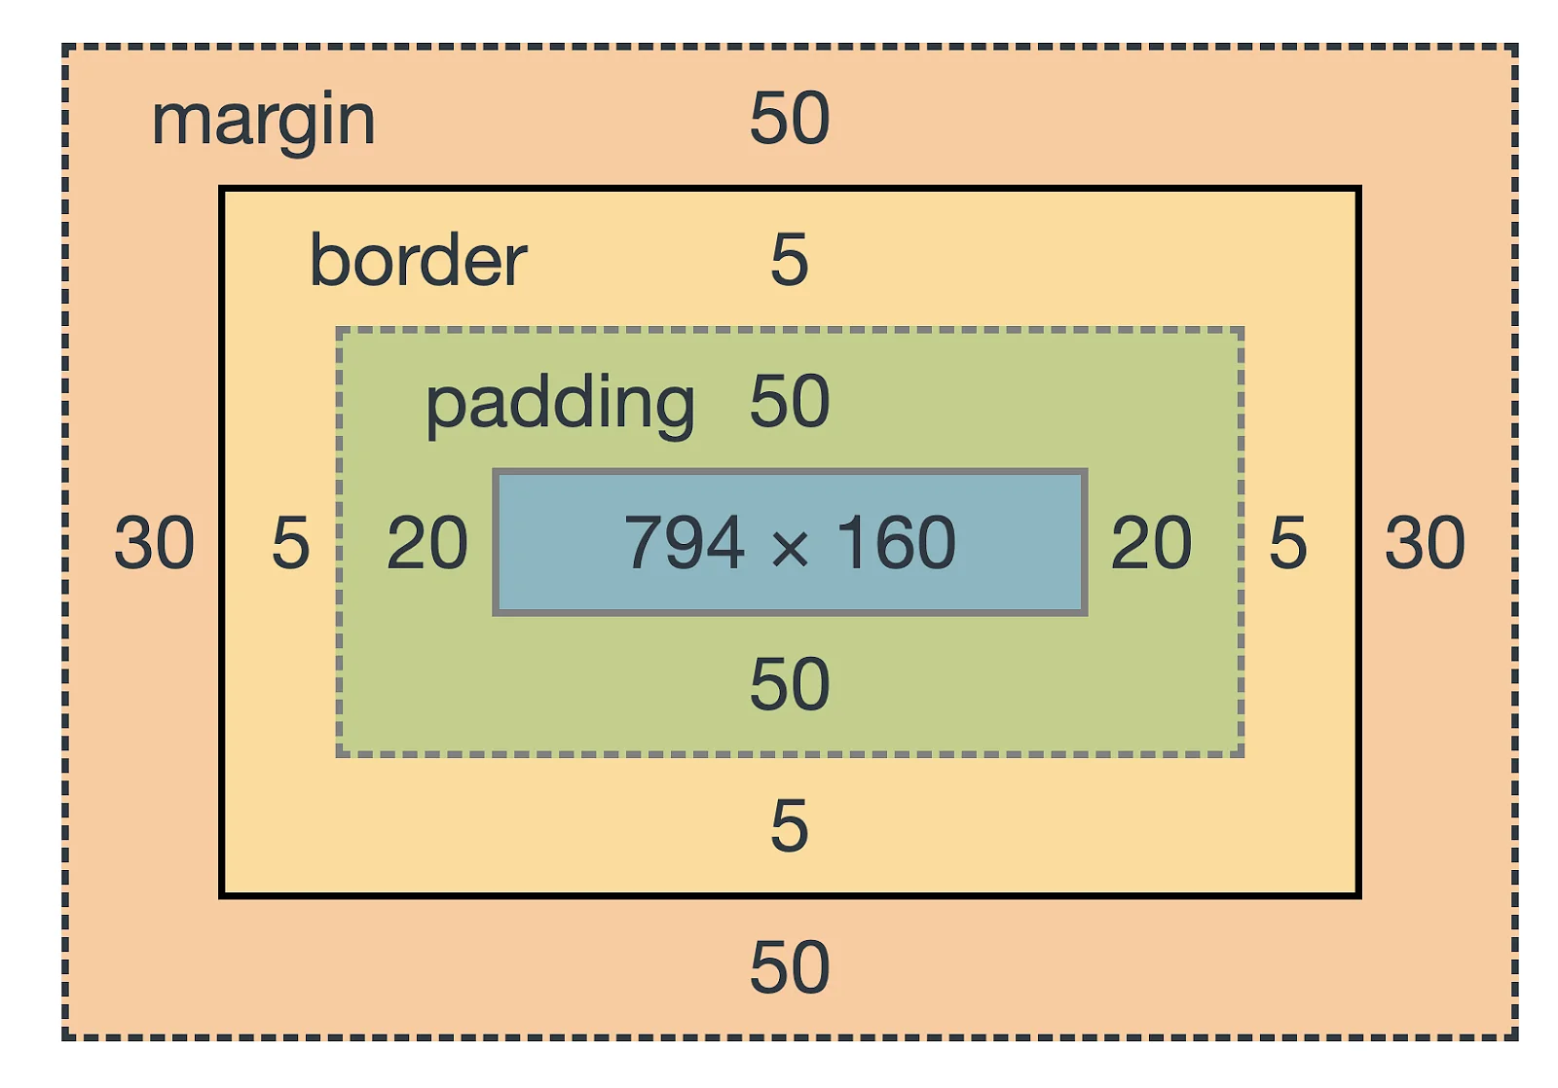
Box modal

Slide 7
border
border-width:
border-style:
border-color:
Shorthand code:-
border: width style color;

Slide 8
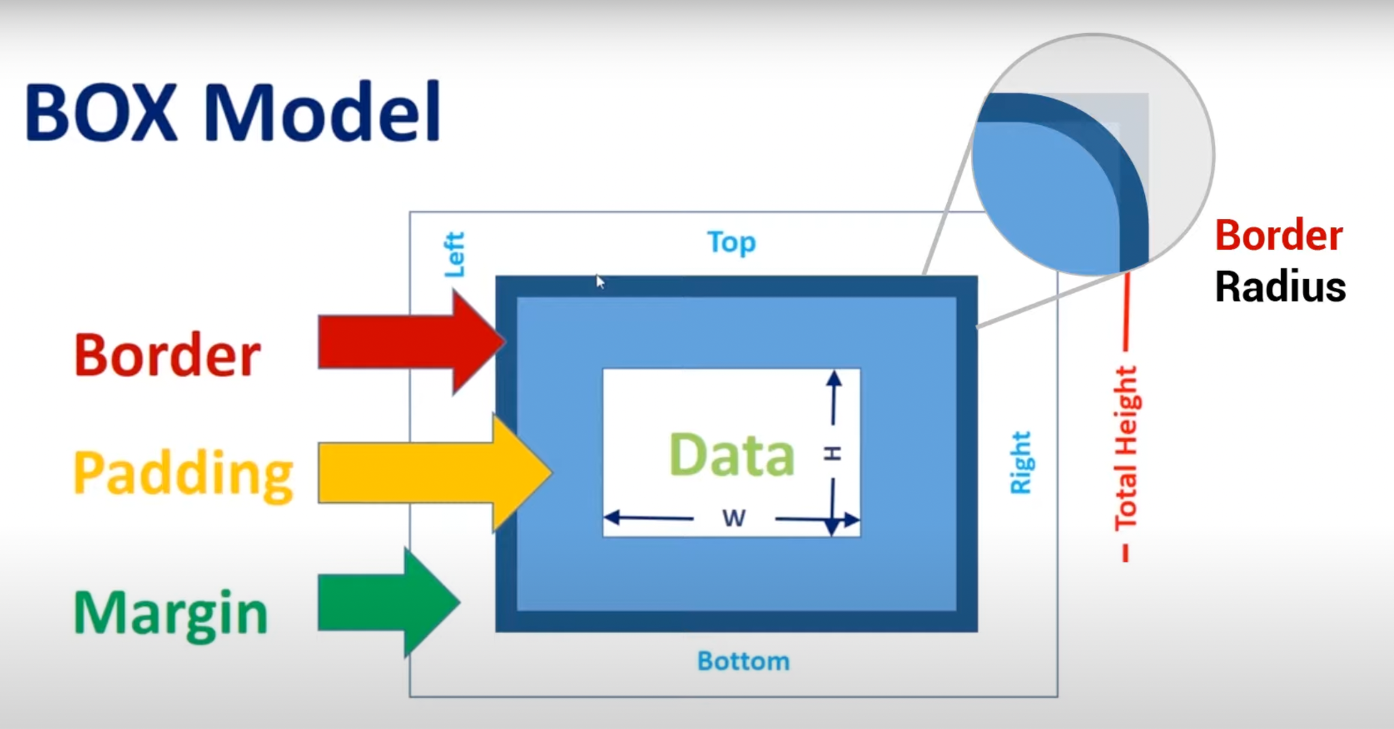
Border radius

Slide 9
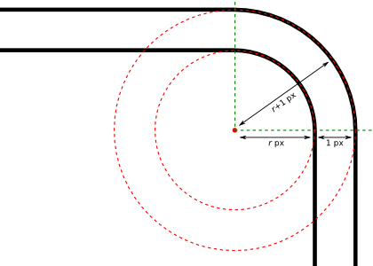
Border radius

Slide 10
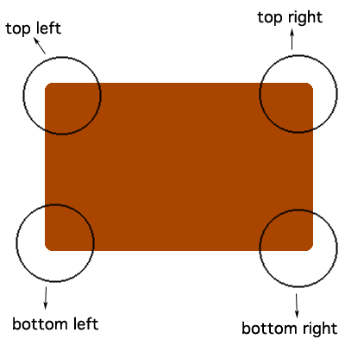
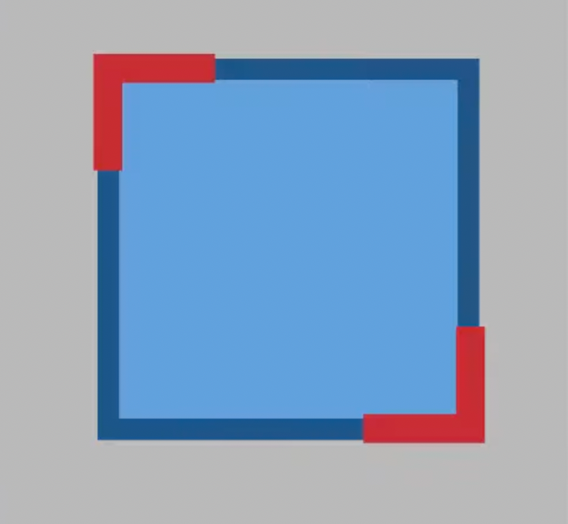
Border radius
Border-radius: 20px 10px

Slide 11
Border radius
border-radius: 20px 10px 15px 30px
20
10
30
15

Slide 12
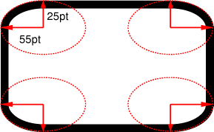
Border radius
border-radius: 55pt / 25pt

Slide 13
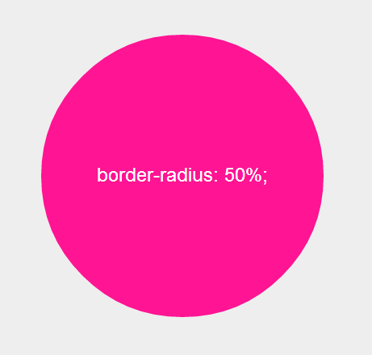
Border radius
border-radius: 50%;

Slide 14
Border image
Border
border-image-source: url(“”);
border-image-slice: 30 ; we can add ‘fill’ to fill center
border-image-repeat: stretch (default)
Repeat
Round
Space
Border-image-outset: 10px;

Slide 15
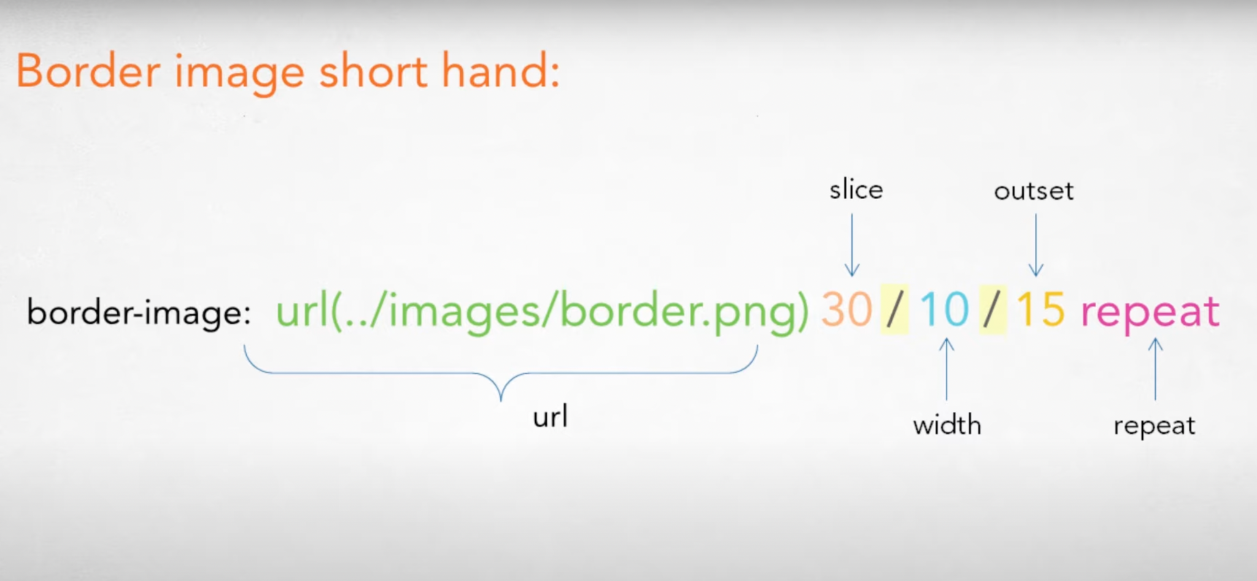
Border image

Slide 16
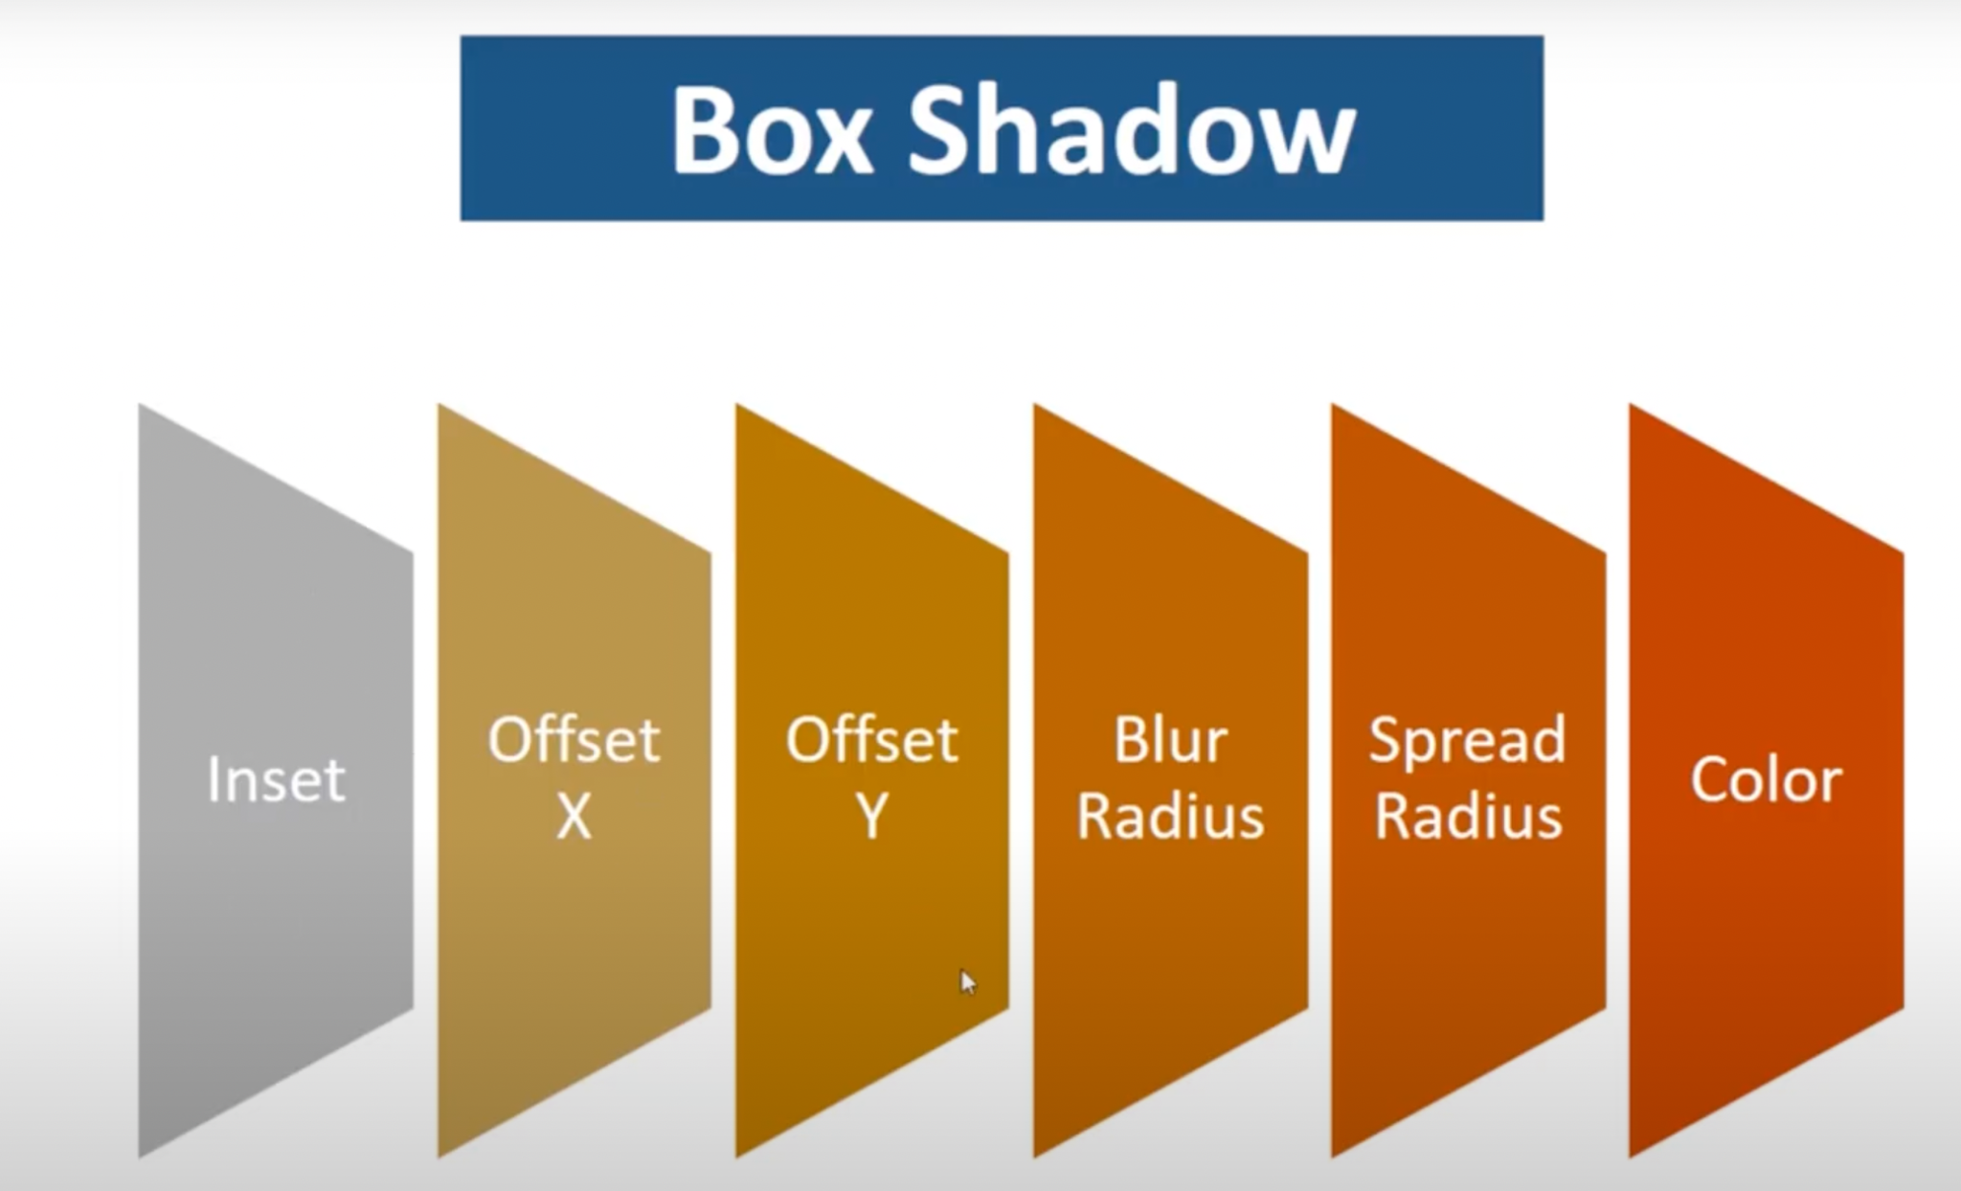
Box Shadow

Slide 17
Box Shadow
Box-shadow: inset, offsetX, offsetY, Blur, Spread, color

Slide 18
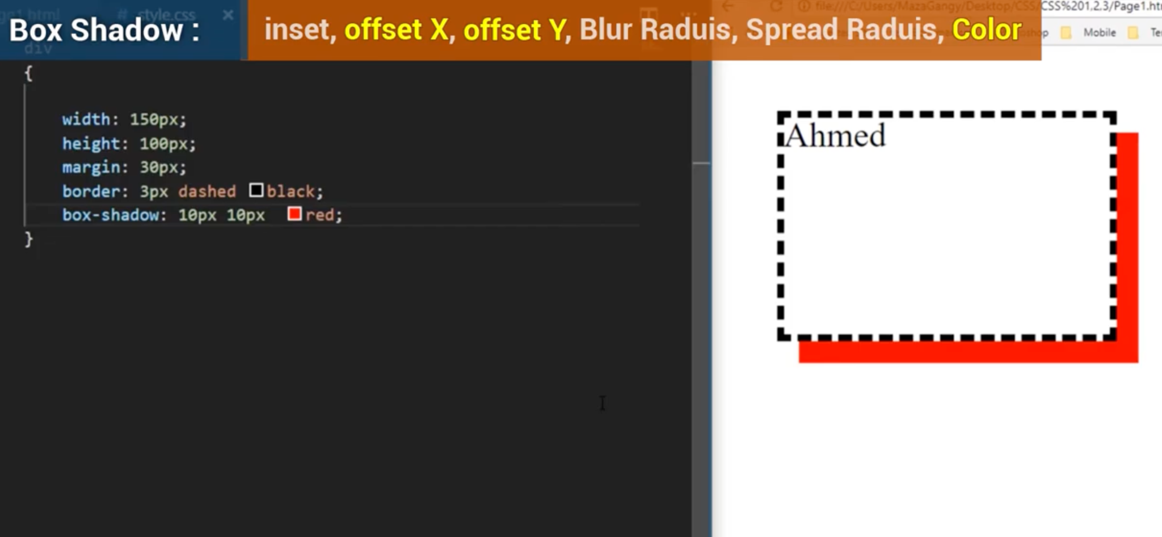
Box Shadow
OffsetX offsetY
Blur
Spread
Color
inset

Slide 19
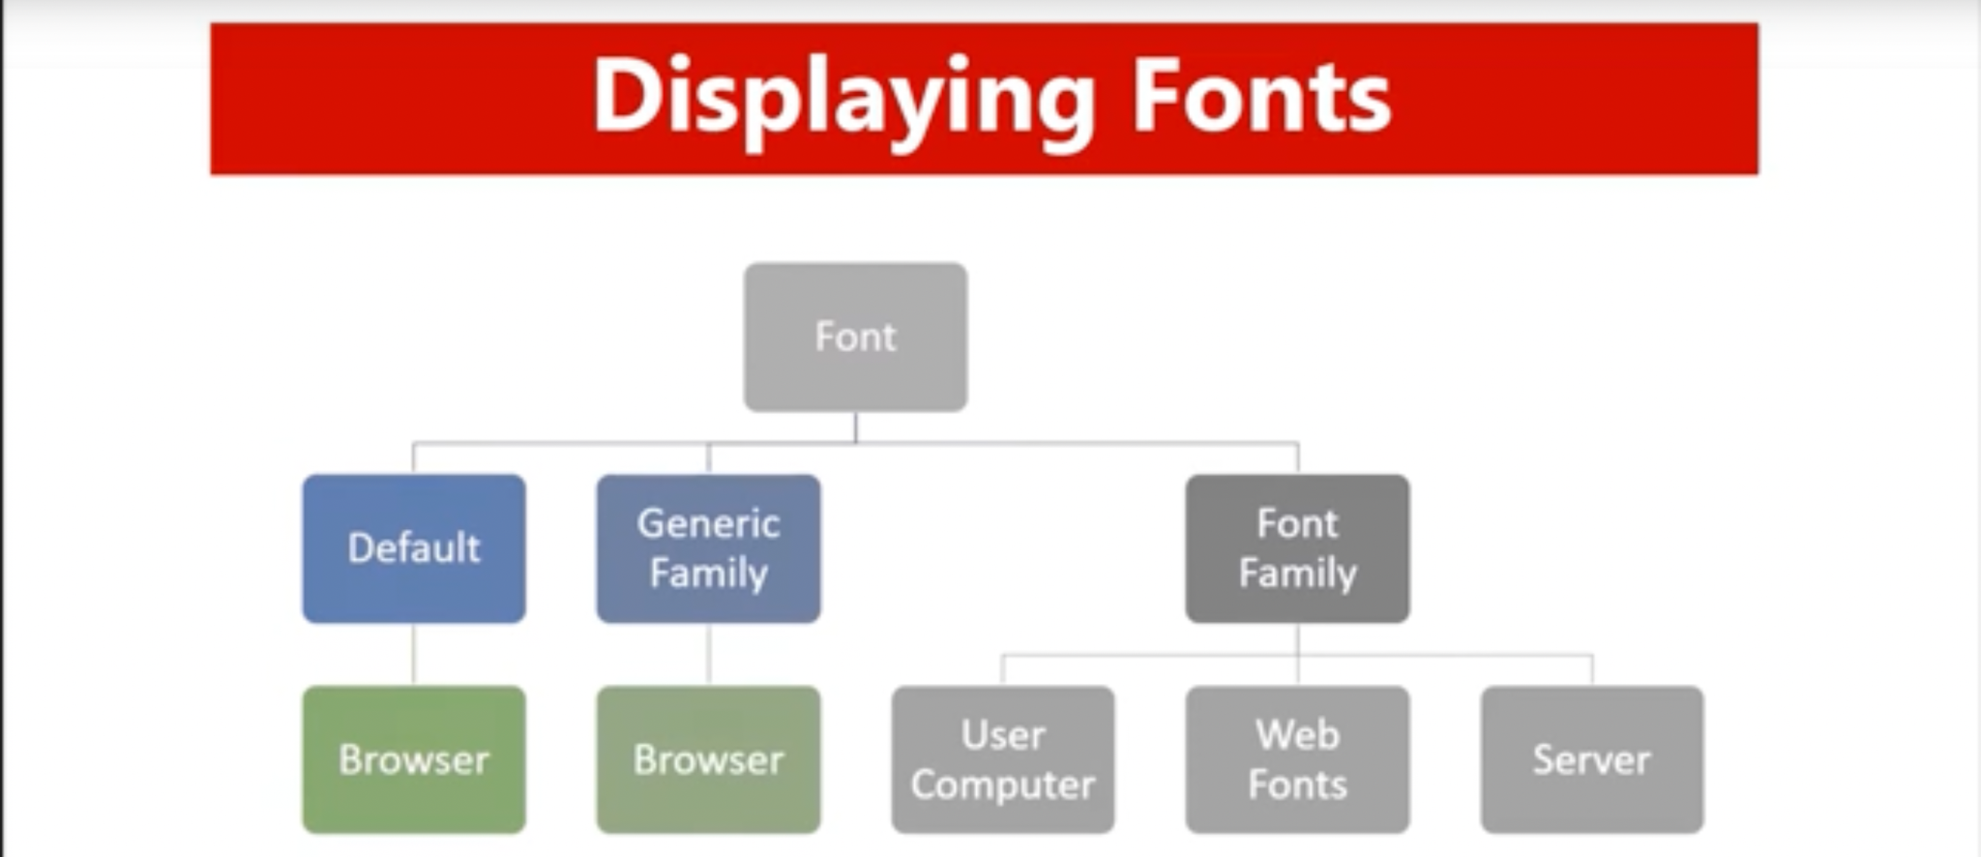
Fonts

Slide 20
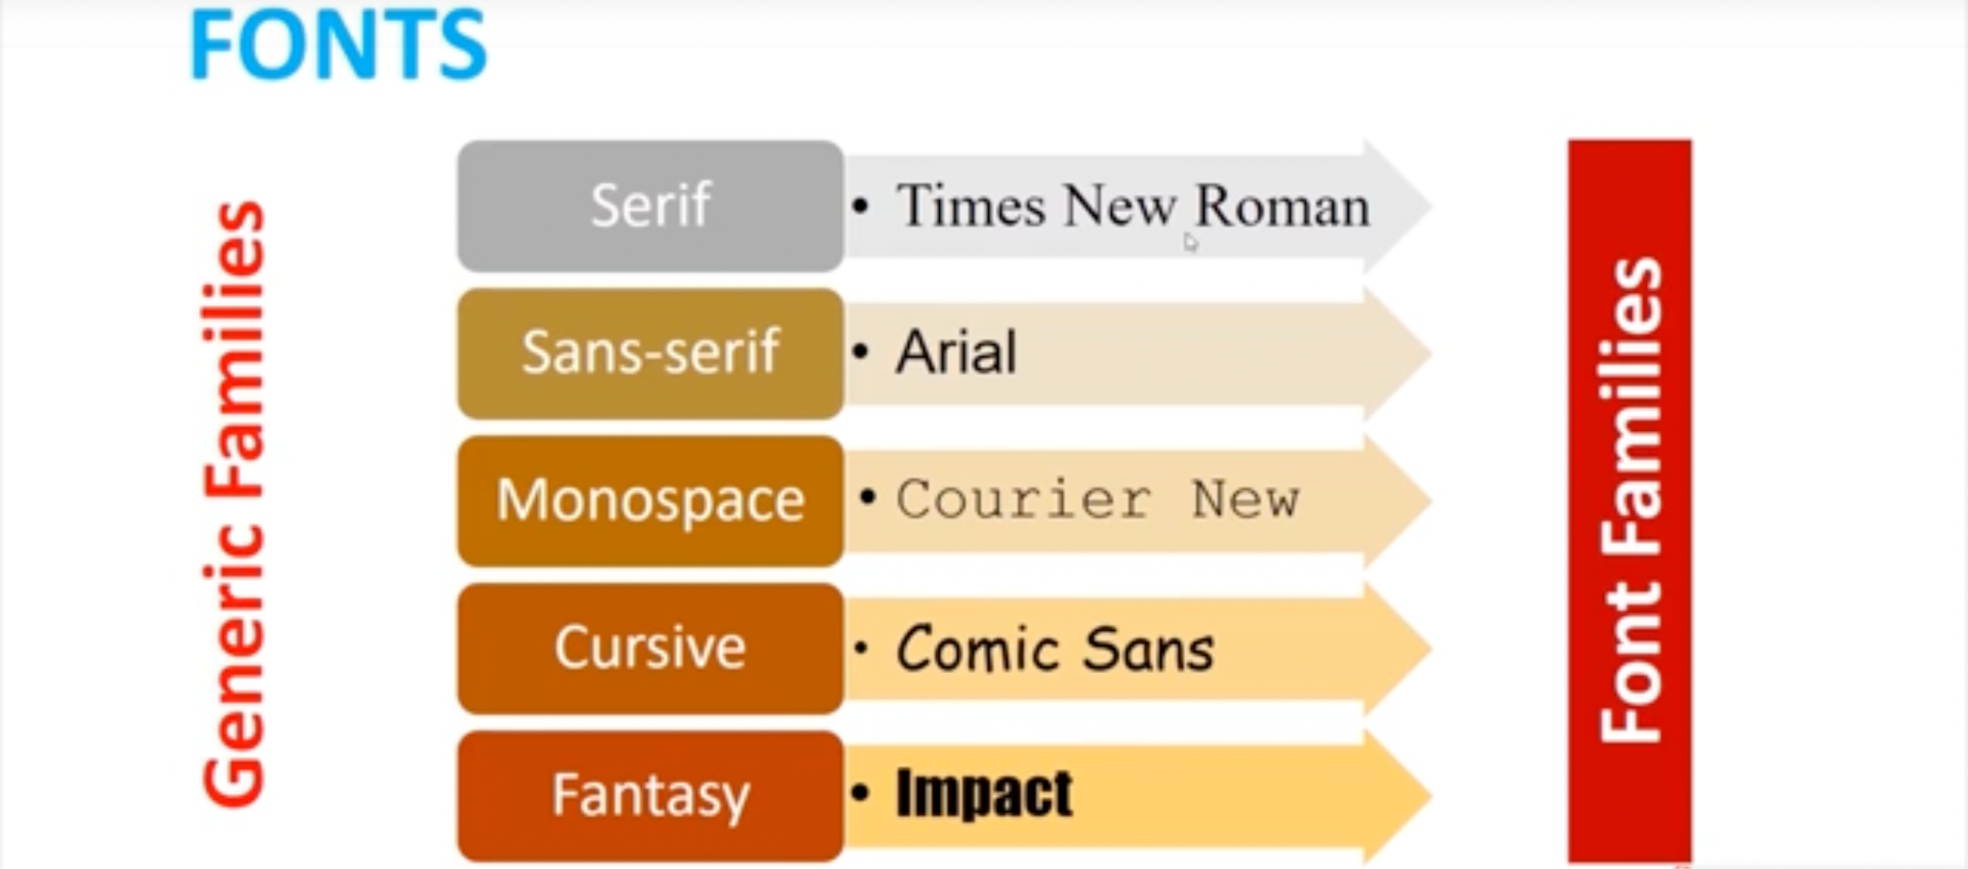
Fonts

Slide 21
Fonts
User Computer: https://www.cssfontstack.com/

Slide 22
Fonts
Web Fonts: https://fonts.google.com/

Slide 23
Fonts
Server Fonts: https://fonts.google.com/ Usage:
@font-face {
font-family: "test";
src: url("/fonts/OpenSans-Regular-webfont.woff2");
}
H1{
font-family:’test’
}

Slide 24

Icons

